Slide 1
NOTES for Presentation
Opening remarks: Kavan
Demo: see next slide
Technical details: use this pres
Closing remarks: dara

Slide 2
NOTES for DEMO
Showcase 4 user stories, everyone needs to participate (which feature will each person work on to showcase?)
Ryan: Create an event and invite
Justin: view events
Dara: Register availabilities
Vish: optimal time
Irf: optimal time
Kavan: Adjust prios

Slide 3
Algorithm: Calculating Optimal Meeting Time
Can be broken down into 2 cases
Professor is not signed up for the event
Professor IS signed up for the event

Slide 4
Algorithm: Prof is NOT signed up
Loop through each day of the week
Find all availabilities for this day
Sort the start times in one array
Sort the end times in another array
Start with a personCount var set to 1
Each time an end time occurs before the next start time, decrement personCount by 1
Each time the next start time occurs before the next end time, increment personCount by 1
Return this day and time when personCount is the largest
If there are no overlapping availabilities, this will be the first availability in the week

Slide 5
Algorithm: Prof IS signed up (slide 1)
Find all the professor’s availabilities that are at least as long as the event
If no such availability exists, this is treated as though the Prof did not sign up
Divide each availability into sub-intervals that are each as long as the event
Ie: event is 1 hour and Prof is free from 12-4 => divide the interval into {[12-1],[1-2],[2-3],[3-4]}
For each subinterval, assign a score to the subinterval and return the time and day of the subinterval with the highest score

Slide 6
Algorithm: Prof IS signed up (slide 2)
How are sub-intervals assigned scores?
Consider all people available during the sub-interval
Must be available for the entirety of the sub-interval
Each person available during the sub-interval has a priority
Sum 100/personPriority for each person available during the sub-interval

Slide 7


Class Architecture: 1
Person
A model reflective of an actual user of some sort: CA, Professor, etc.
Availability
Helps us keep track of information about when a particular user is available for a certain event
Essentially a continuous timeslot for when that user is free (Start Time - End Time on dow)
Wanted to separate this from a Person - high cohesion & low coupling
Notes:
Don’t list the fields.

Slide 8
Class Architecture: 2
Event
Allow professors to coordinate with other staff members - ultimately, algorithm is run as a combination of information from Event model and Availability model
Separation between participants and the events they are participating in
Participant
Allows a professor to label individual people as participants using just a mapping to their email (still a unique identifier of a Person)
Differs from Person - reduces the number of queries necessary to “invite” people to a given event and stops us from doing a costly SQL “join” operation

Slide 9
Presentation order
Kavan starts sharing (has pres and app open) and gives opening remarks
Demo
Kavan creates a demo event for an hour and invite yash, irf, vish, ryan (ryan voice over)
Kavan goes to view events and shows off that page (justin voice over)
Kavan registers Ali for 2 time slots for example (dara voice over)
Irf, ryan, vish, and justin then register 4 other people for their availabilities
Irf and vish then do optimal time and present the example
Kavan will do adjust prio and show how that changes time
Ryan will do Javalin, spark, and heroku
Kavan introduces UML and justin explains
Dara closes
https://guarded-tor-51281.herokuapp.com

Slide 10


Notes:
Start Here!

Slide 11

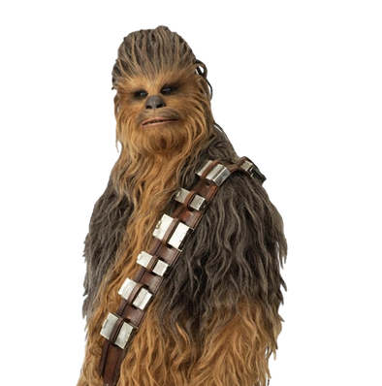


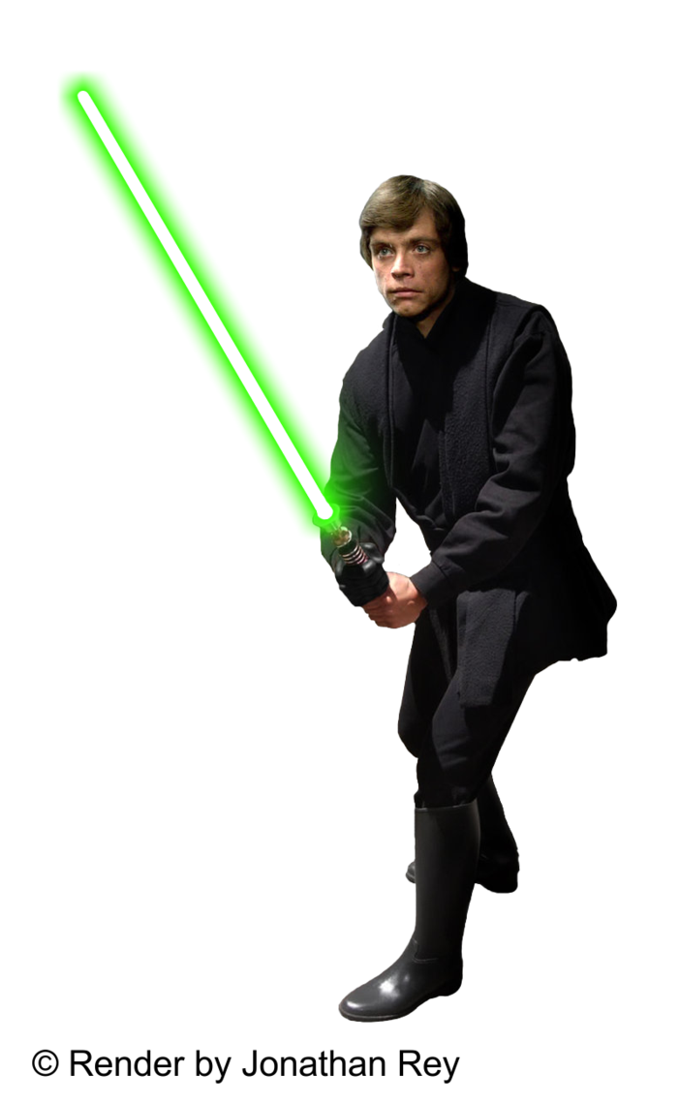

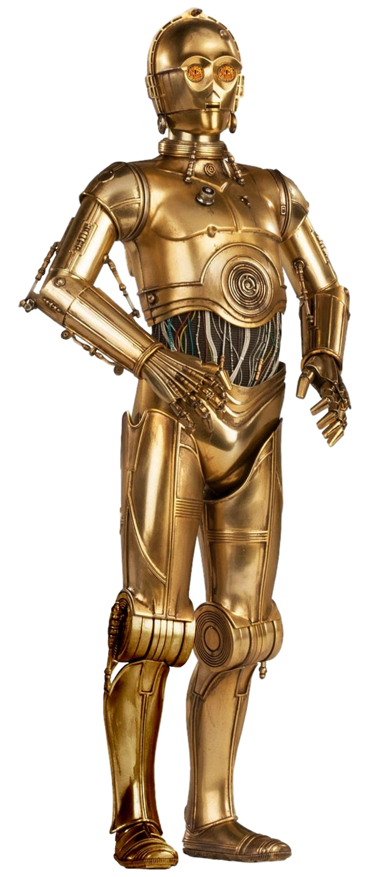
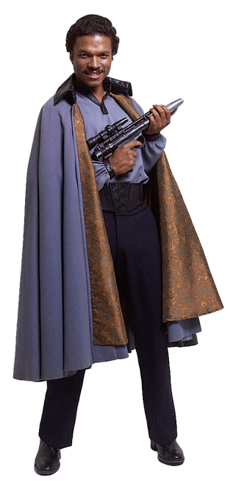
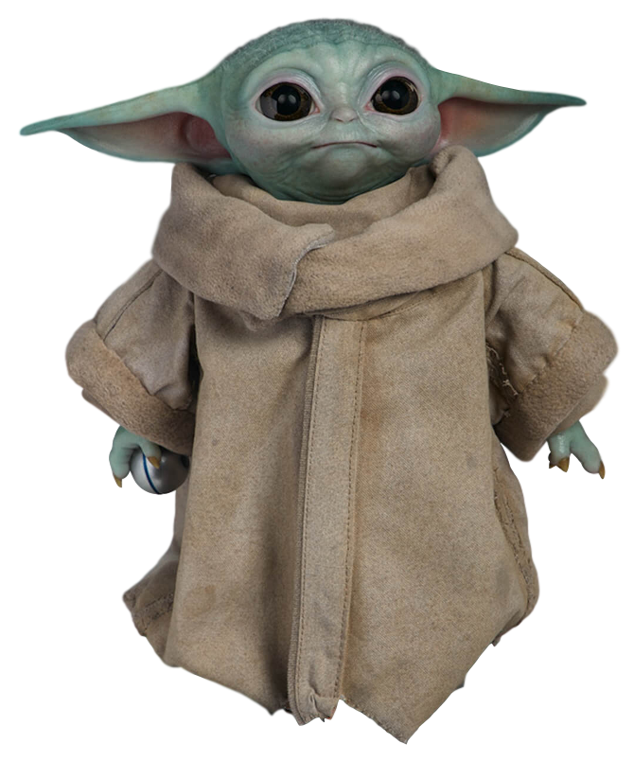
You

Slide 12
What are the options?
When2Meet: https://www.when2meet.com/?9088356-cRIRi
Doodle: https://doodle.com/poll/rhwcmdgyusz8qhmz

Slide 13
Prioriteams

Slide 14
Prioriteams
Priority-Based Scheduling
Ryan Hubley, Vishnu Joshi, Irfan Jamil,
Kavan Bansal, Justin Song, Dara Moini

Slide 15
What is Prioriteams?
Intuitive meeting-scheduling web application
Determines optimal meeting time when most people (especially high-priority) can attend
Useful for CA staff meetings, corporate, parties, and more
Unlike any existing alternative

Slide 16
Functional Requirements Demo

Slide 17
User Story 1

Slide 18
“As a Professor, I want to be able to create an event so that I am able to organize a meeting with my CAs.”
Notes:
User Story for Adjust Priorities

Slide 19
User Story 2

Slide 20
“As a CA, I would like a way to view all the events scheduled by the Professor”
Notes:
User Story for Adjust Priorities

Slide 21
User Story 3

Slide 22
“As a Student, I would like to enter my availabilities for a specific event so that they will be considered when selecting the event meeting time .”
Notes:
User Story for Adjust Priorities

Slide 23
User Story 4

Slide 24
“As a Professor, I want the software to generate the optimal time for whatever event I choose”
Notes:
User Story for Adjust Priorities

Slide 25
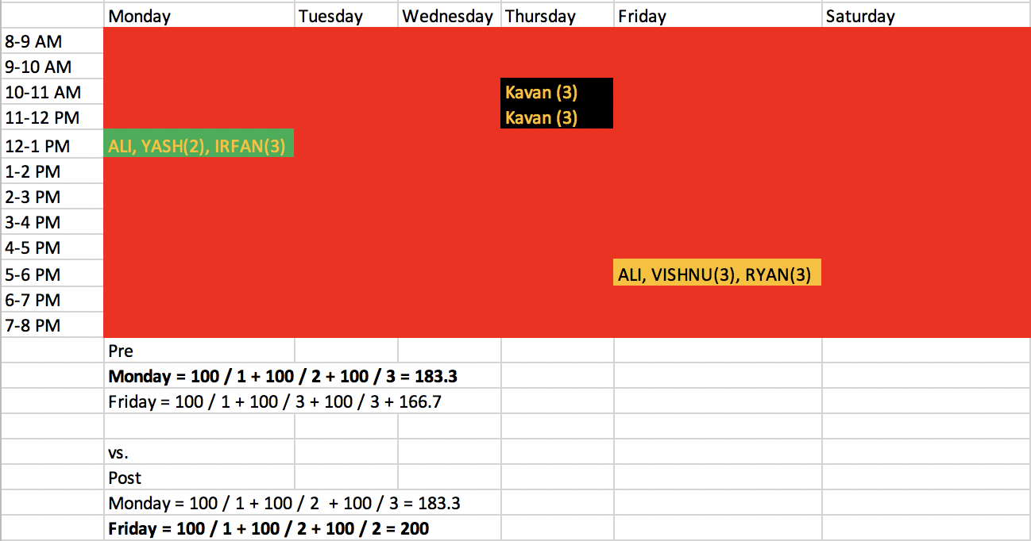

Slide 26
User Story 5

Slide 27
“As a Professor, I want to be able to set priorities to the CAs so that the people I need most can attend the meeting.”
Notes:
User Story for Adjust Priorities

Slide 29
Technical Details
Notes:
Rename this to something else (or move UML first)

Slide 30

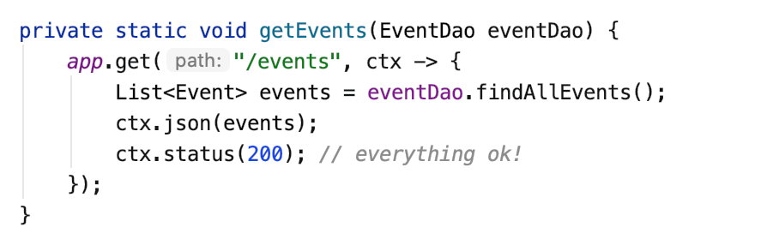

Slide 31

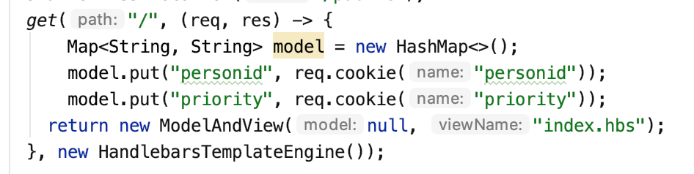

Slide 32

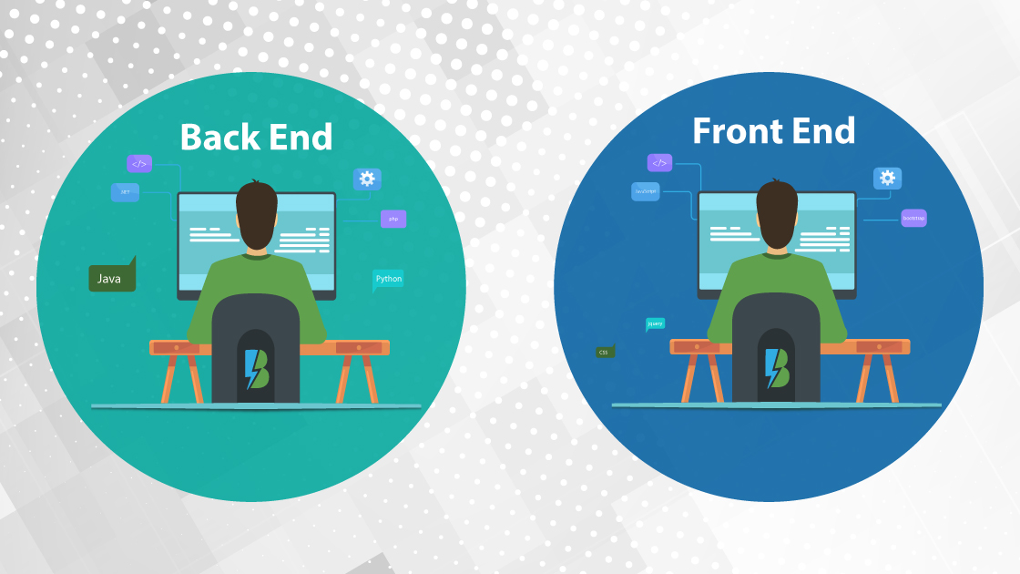

Slide 33
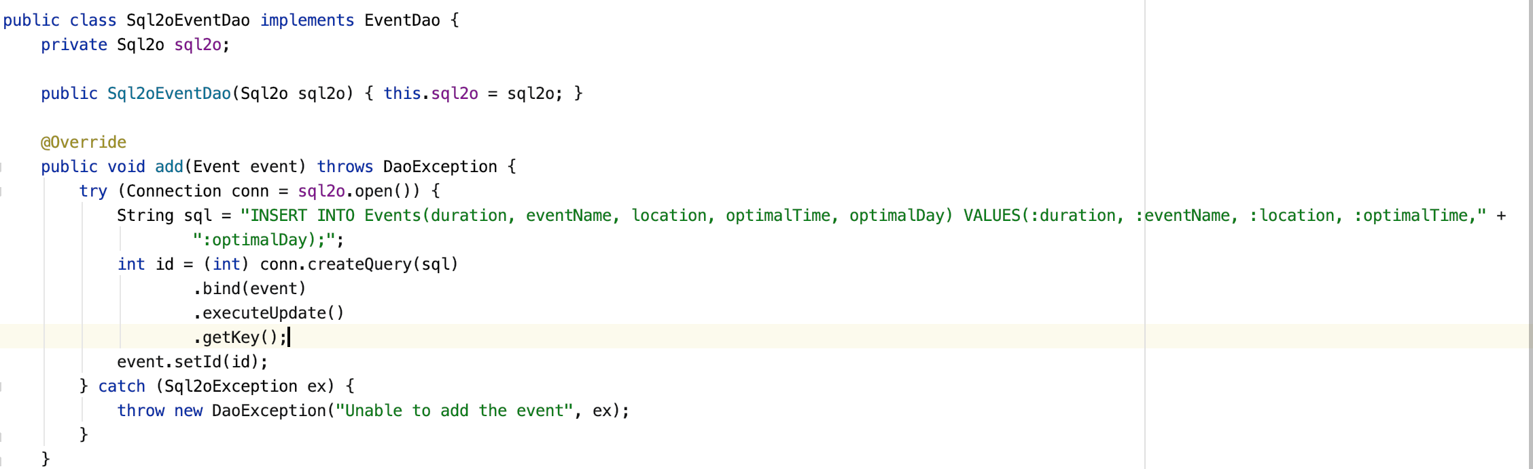
Data Access Objects (DAOs)

Slide 34
Class Architecture

Slide 35
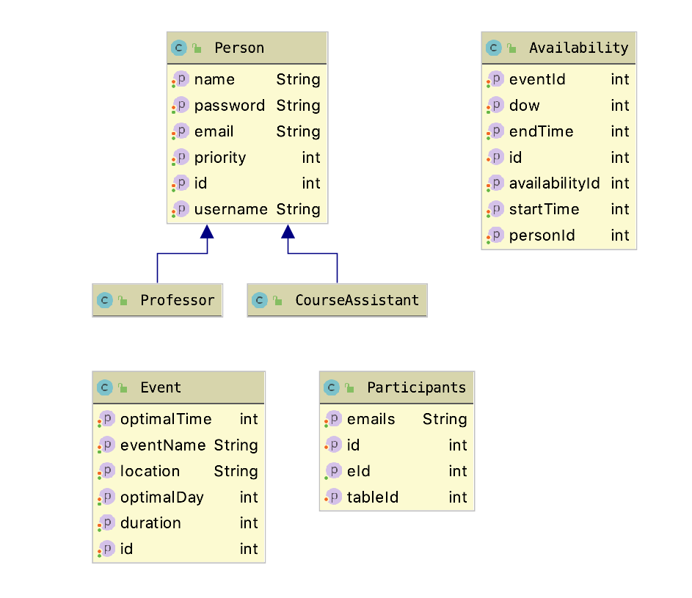

Slide 36
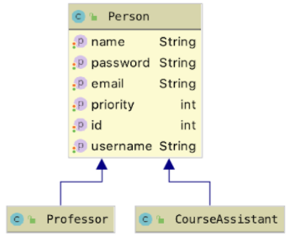
Person
Person has a priority, critical to understanding
Each person as a person id, which is used to join various tables
Each person as an associated email address

Slide 37
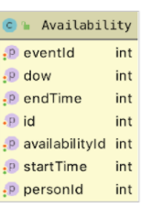
Availability
Helps us keep track of information about when a particular user is available for a certain event.
Essentially a continuous timeslot for when that user is free

Slide 38
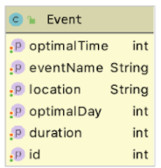
Event
Allow professors to coordinate with other staff members
Algorithm calculates the most optimal time and day to hold the event

Slide 39
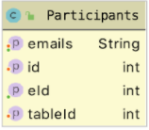
Participants
Essentially an email list
Allows a professor to label individual people as participants using just a mapping to their email
Is very helpful for inviting participants for a specific event
More efficient to keep separate than performing costly “join” SQL operation

Slide 40
Limitations
Algorithm/Availabilities only considers intervals on the hour
When the Professor is not registered for an event, priorities are not considered
Algorithm does not deal with location conflicts
Person has the same priority across all events
Assumes events are recurring

Slide 41
Looking Ahead
Take in availabilities so that they can start and end at any time
Factor in priorities into algorithm even when the Prof is not available
Align the application to the more general use case
Trivial Updates:
Have algorithm deal with location conflicts
Let an event be a one-off event
Format UI in such a way that entering availabilities is easier

Slide 42
Takeaway/Reflections
Larger the project became, the more complex the code became
Highlighted importance of planning and brainstorming in advance/more coordination and communication.
Slow start caused second half of the semester to be more intense
Best iterations involved doing most of the work early
Overall, the OOSE went well. Project was a vessel to learn software practices and methods

Slide 43
Questions?

